Slide 1

IDB-BISEW IT Scholarship Project Networking Technologies Course
PRESENTED
Tohin Hossain
ID:1204199
Round-28

Slide 2
What is mesh topology?
A mesh network is a network topology in which each node relays data for the network. All mesh nodes cooperate in the distribution of data in the network.

Slide 3
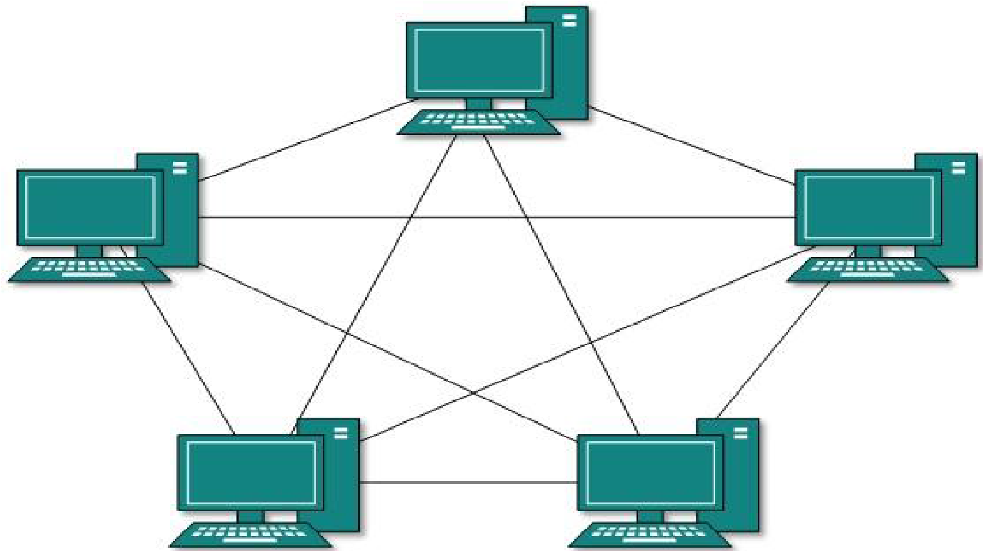
A Mesh Topology Picture

Slide 4
Types of mesh topology
Full Mesh
Partial Mesh
Wired Mesh
Wireless Mesh

Slide 5
How Mesh Topology Connect Computer Networks in Organizations?
In mesh topology, every node has a direct point-to- point connection to every other node. Because all connections are direct, the network can handle very high-volume traffic. It is also robust because if one connection fails, the others remain intact. Security is also high since data travels along a dedicated connection.

Slide 6
Mesh Topology: Advantages
1) Data can be transmitted from different devices simultaneously. This topology can withstand high traffic. 2) Even if one of the components fails there is always an alternative present. So data transfer doesn’t get affected. 3) Expansion and modification in topology can be done without disrupting other nodes.

Slide 7
Mesh Topology:DisAdvantages
1) There are high chances of redundancy in many of the network connections. 2) Overall cost of this network is way too high as compared to other network topologies. 3) Set-up and maintenance of this topology is very difficult. Even administration of the network is tough.

Slide 8



